Slide 1
Introduction to Computing
Lecture 4: Operations on Data

Slide 2
Objective
After studying this chapter, the student should be able to:
❑ List the three categories of operations performed on data. ❑ Perform unary and binary logic operations on bit patterns. ❑ Distinguish between logic shift operations and arithmetic shift operations. ❑ Perform logic shift operations on bit patterns. ❑ Perform arithmetic shift operations on integers stored in two’s complement format.

Slide 3
Objective
After studying this chapter, the student should be able to:
❑ Understand some applications of logical and shift operations such as setting, unsetting, and flipping specific bits
❑ Perform addition and subtraction on integers when they are stored in two’s complement format.

Slide 4
LOGIC OPERATIONS
Notes:
Các hệ số

Slide 5
Logic operations at bit level
DATA TYPES
❑ Interpret 0 as the value false and 1 as the value true: apply the operations defined in Boolean algebra to manipulate bits.
❑ Four bit-level operations that are used to manipulate bits: NOT, AND, OR, and XOR.
❑ Truth table: define the values of output for each possible input or inputs.
❑ Output of each operator is always one bit, but the input can be one or two bits.
Notes:
Hệ đếm theo vị trí của ký số (Positional number system)

Slide 6
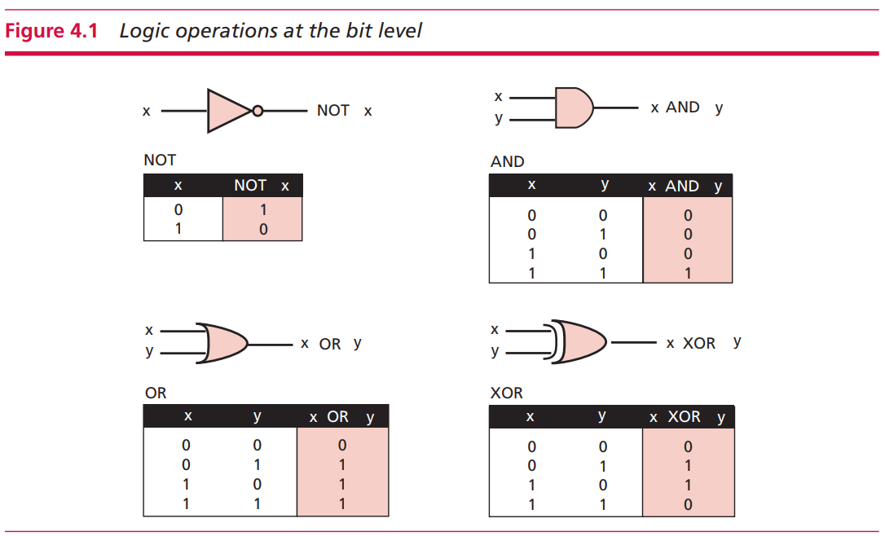

Slide 7
Logic operations at bit level
NOT operator: unary operator - one input.
The output bit is the complement of the input (1 => 0, 0 => 1).
AND operator: binary operator - two inputs.
The output bit is 1 if both inputs are 1s and the output is 0 in the other three cases.
OR operator: binary operator.
The output bit is 0 if both inputs are 0s and the output is 1 in the other three cases.
XOR operator (pronounced ‘exclusive-or’) - binary operator
The output is 0 if both inputs are 1s.

Slide 8
Logic operations at bit level
NOT operator: unary operator - one input.
The output bit is the complement of the input (1 => 0, 0 => 1).
AND operator: binary operator - two inputs.
The output bit is 1 if both inputs are 1s and the output is 0 in the other three cases.
OR operator: binary operator.
The output bit is 0 if both inputs are 0s and the output is 1 in the other three cases.
XOR operator (pronounced ‘exclusive-or’) - binary operator
The output is 0 if both inputs are 1s.

Slide 9
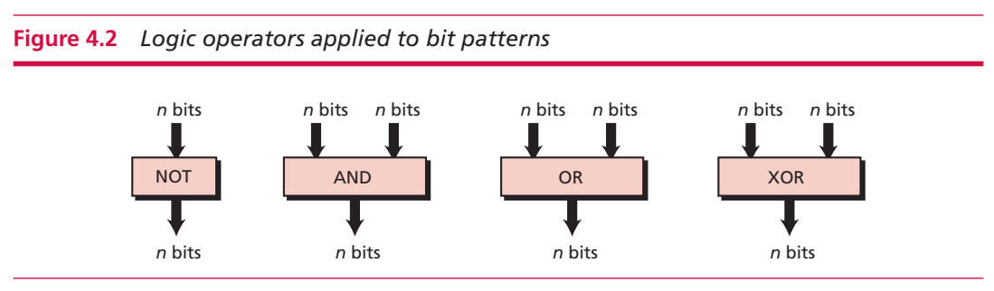
Logic operations at pattern level
Four operators (NOT, AND, OR, and XOR) can be applied to an n-bit pattern.
The effect is the same as applying each operator to each individual bit for NOT and to each corresponding pair of bits for other three operators

Slide 10
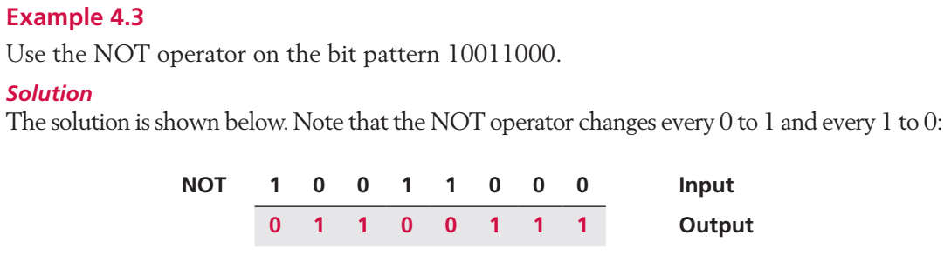
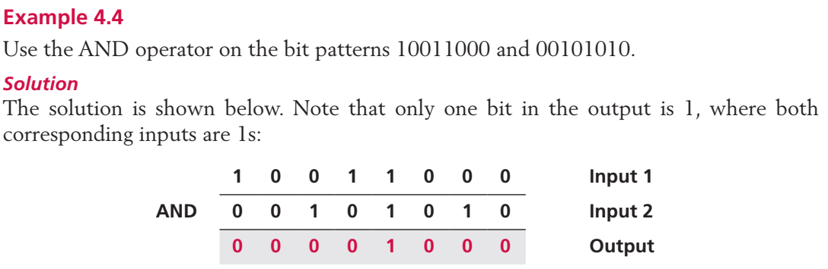
Example
Notes:
Số nguyên
Không có phần thập phân

Slide 11
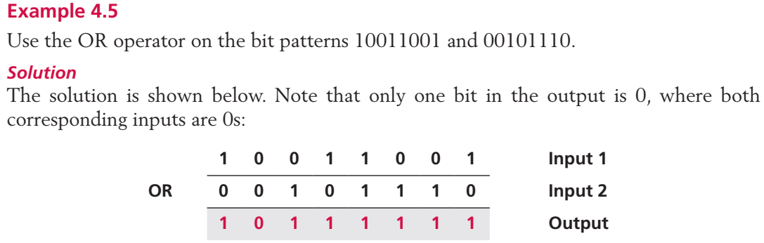
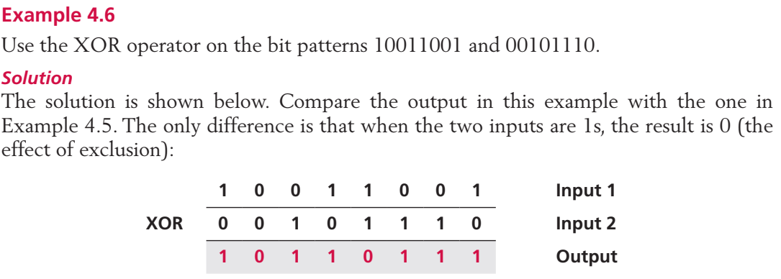
Example
Notes:
Số nguyên
Không có phần thập phân

Slide 12
Applications
Four logic operations can be used to modify a bit pattern.
Complementing: change 1 to 0 and 0 to 1 to every bit by NOT operator.
Unsetting specific bits: setting specific bit to 0 by using AND operator.
Setting specific bits: setting specific bit to 1 by using OR operator.
Flipping specific bits: flip (complement) specific bits in a bit pattern using XOR.
NOT operator flips all bit.

Slide 13
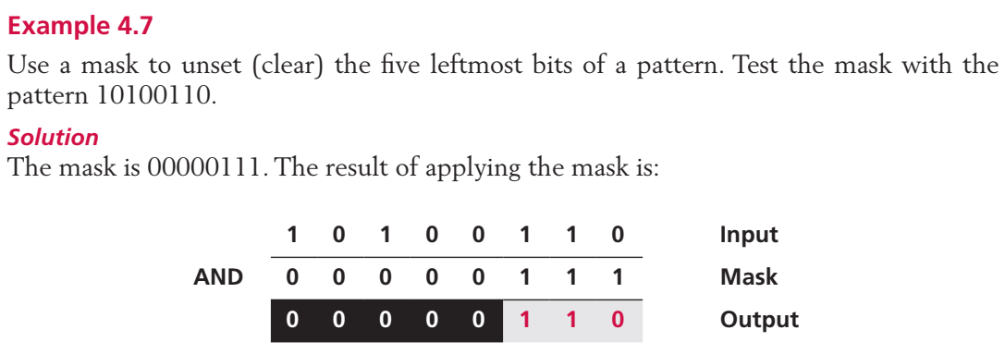
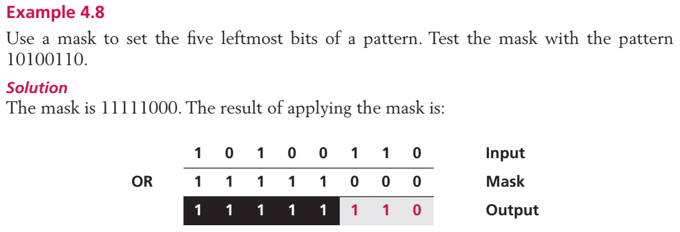
Example
Notes:
Số nguyên
Không có phần thập phân

Slide 14
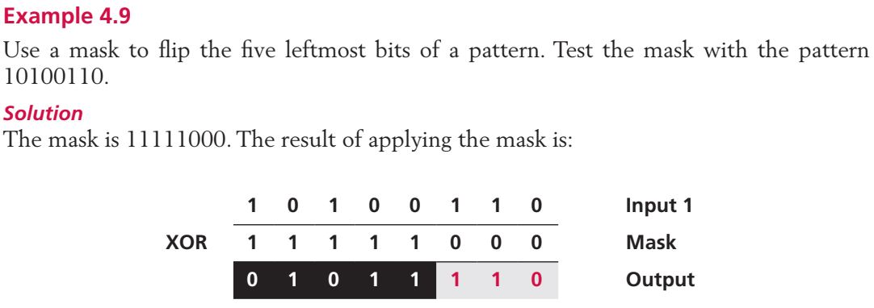
Example
Notes:
Số nguyên
Không có phần thập phân

Slide 15
SHIFT OPERATIONS
Notes:
Các hệ số

Slide 16
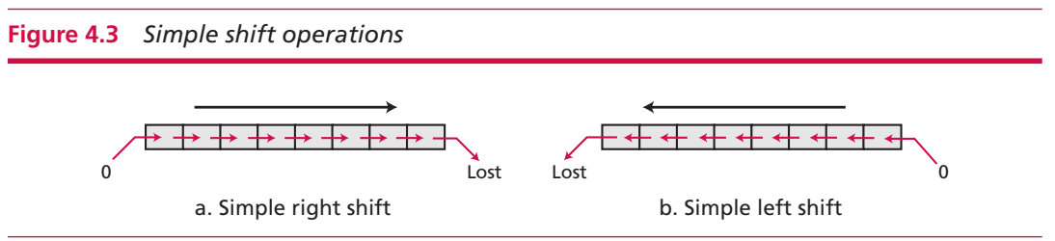
Logical shift operations
Logical shift operation is applied to a pattern that does not represent a signed number.
Simple right/left shift: shifts each bit one position to the right or left.
Right shift: the rightmost bit is lost and a 0 fills the leftmost bit.
Left shift: the leftmost bit is lost and a 0 fills the rightmost bit.

Slide 17
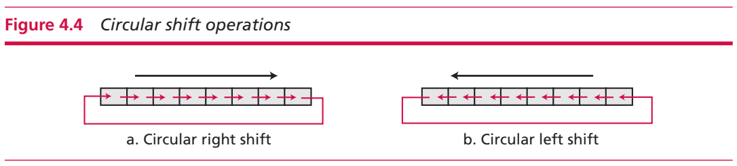
Logical shift operations
Logical shift operation is applied to a pattern that does not represent a signed number.
Circular shift: shifts bits, but no bit is lost or added.
Right shift: the rightmost bit is circulated and becomes the leftmost bit.
Left shift: the leftmost bit circulates and become the rightmost bit

Slide 18
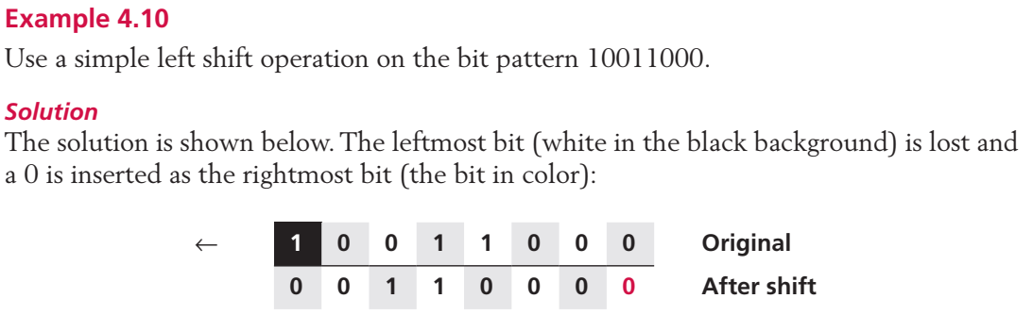
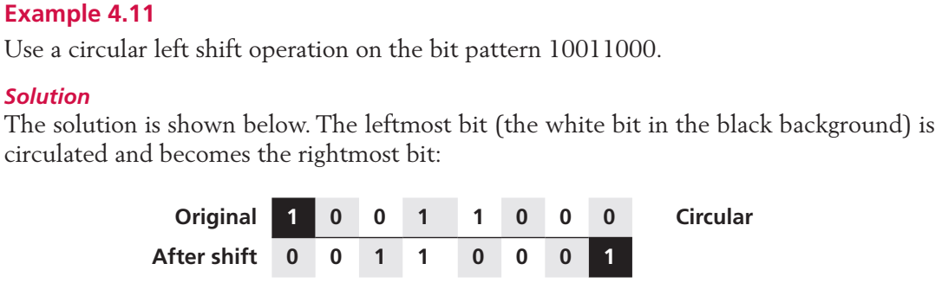
Example
Notes:
Số nguyên
Không có phần thập phân

Slide 19
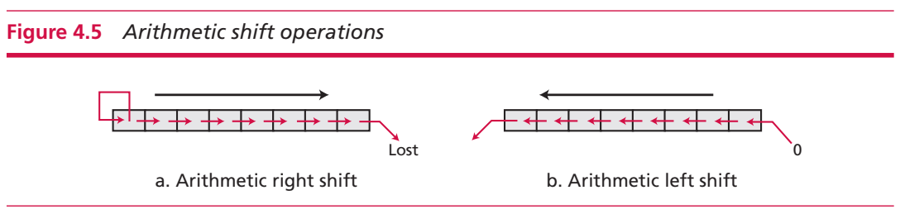
Arithmetic shift operations
Assume that the bit pattern is a signed integer in two’s complement format.
Arithmetic right shift is used to divide an integer by two.
retains the sign bit, so that the sign is preserved
Arithmetic left shift is used to multiply an integer by two
discards the sign bit and accepts the bit to the left of the sign bit as the sign

Slide 20
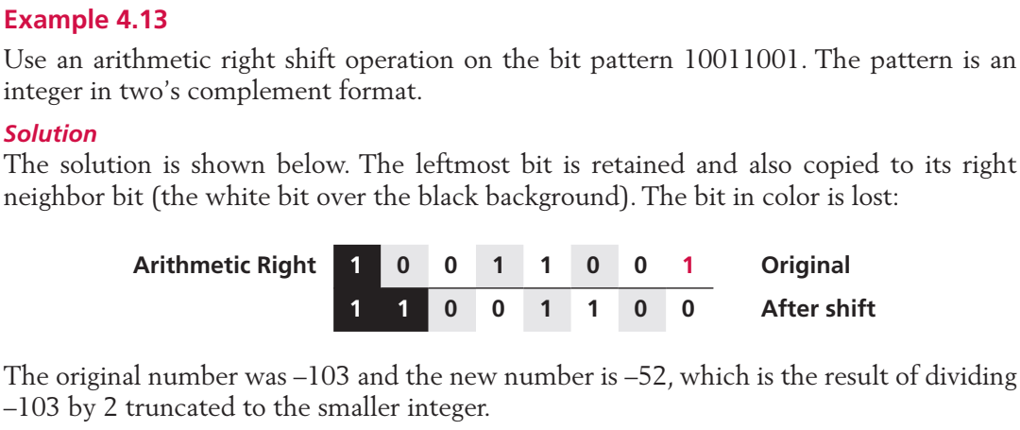
Example
Notes:
Số nguyên
Không có phần thập phân

Slide 21
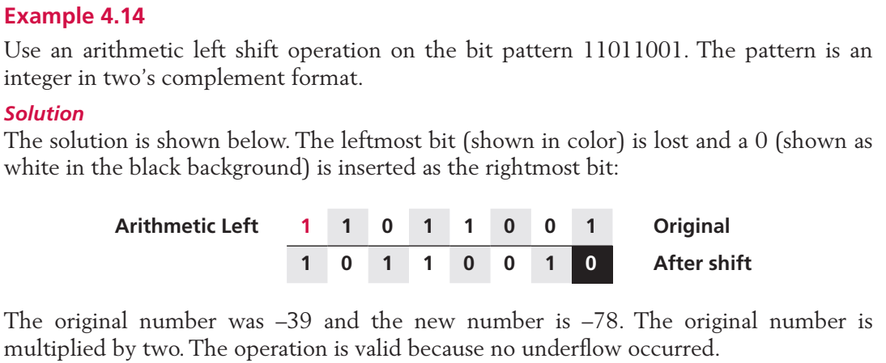
Example
Notes:
Số nguyên
Không có phần thập phân

Slide 22
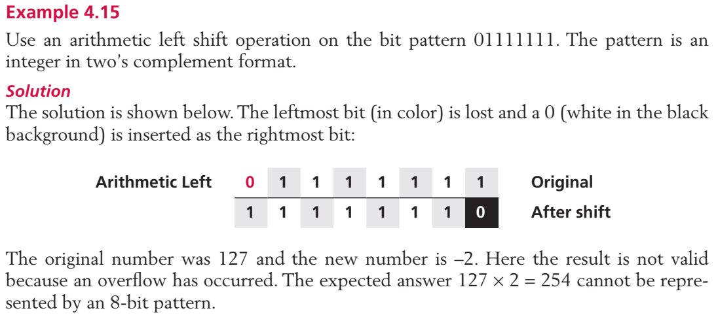
Example
Notes:
Số nguyên
Không có phần thập phân

Slide 23
ARITHMETIC OPERATIONS
Notes:
Các hệ số

Slide 24
ARITHMETIC OPERATIONS
Involve adding, subtracting, multiplying, and dividing.
Can apply these operations to integers and floating-point numbers.
Only discuss addition and subtraction for two’s complement integers

Slide 25
Addition and subtraction for two’s complement integers
Advantages: no difference between addition and subtraction.
Subtraction operation: the computer simply changes it to an addition operation, but makes two’s complement of the second number.

Slide 26
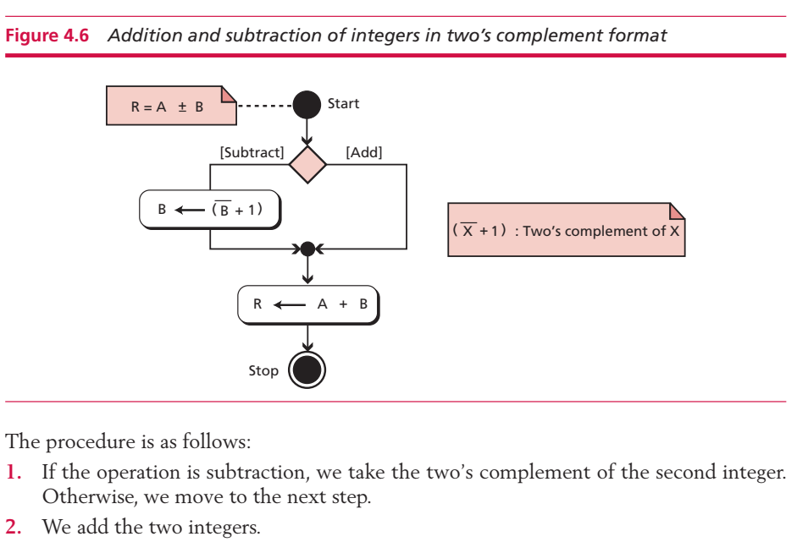
Addition and subtraction for two’s complement integers

Slide 27
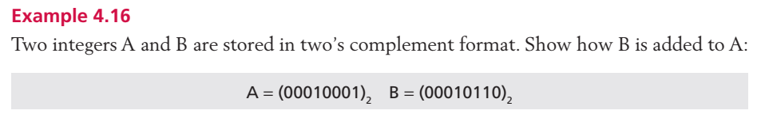
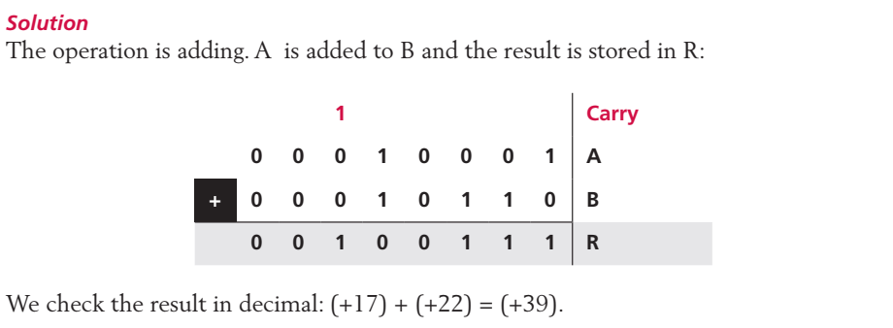
Example

Slide 28
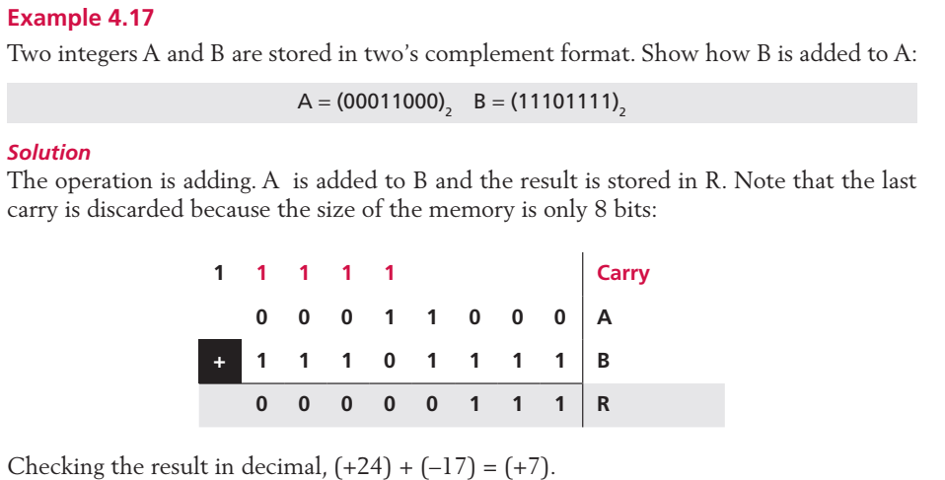
Example

Slide 29
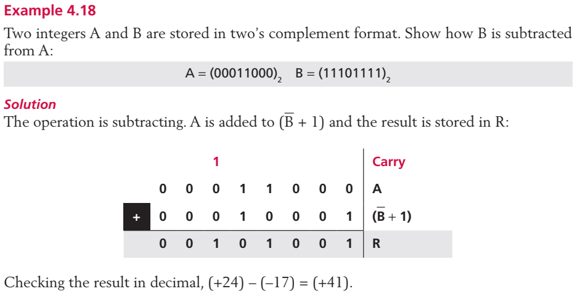
Example

Slide 30
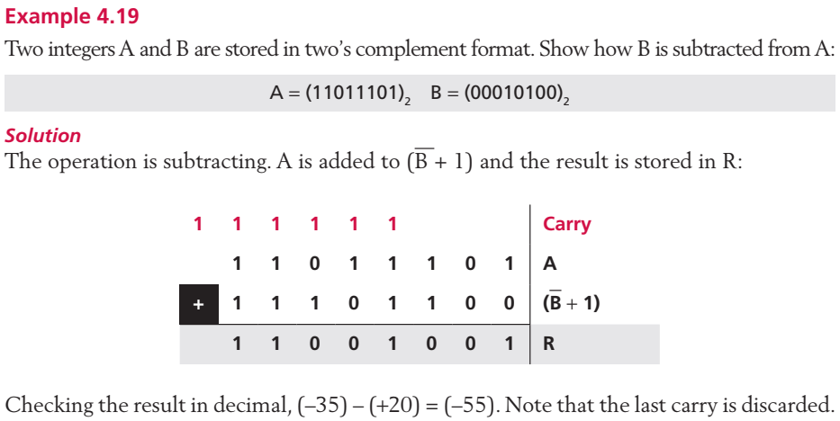
Example

Slide 31
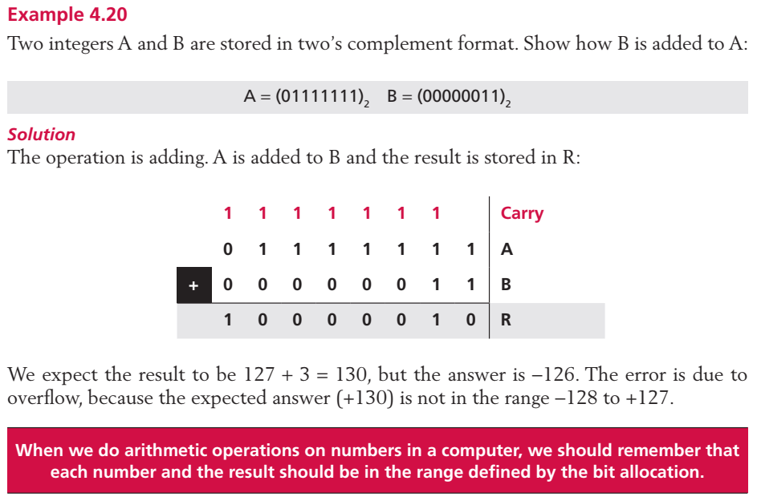
Example

Slide 32
Practice
Notes:
Các hệ số

Slide 33
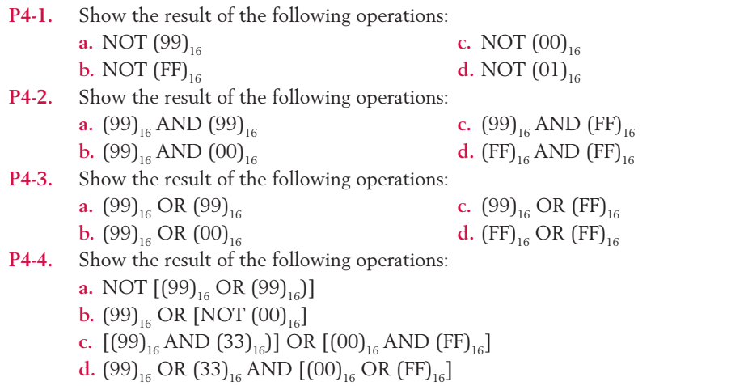
Practice

Slide 34
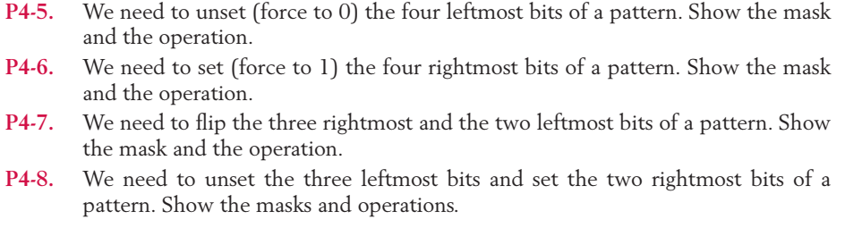
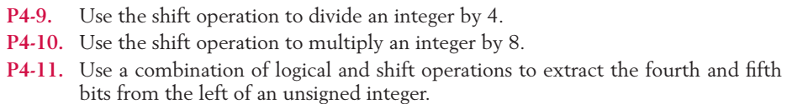
Practice

Slide 35
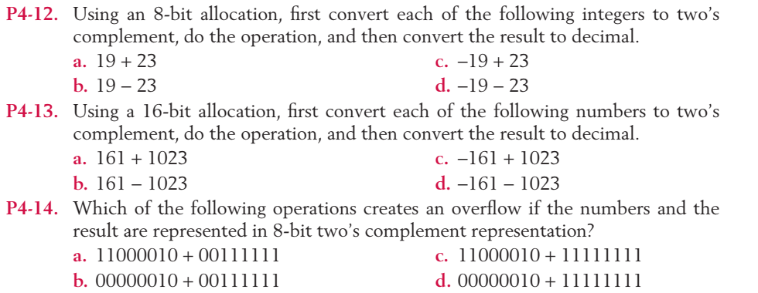
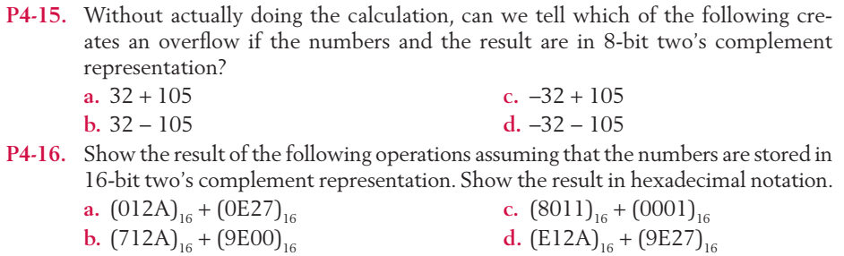
Practice

Slide 36
Q & A

